Slide 1
Data Analysis
for ICC Cricket World Cup 2023
Lavanya Mehrish- 1RVU23CSE234
Yashmeet Baid- 1RVU23CSE547
Sristi Losalka- 1RVU23CSE472

Slide 2
INTRODUCTION
INTRODUCTION
Established in 1975, the ICC Cricket world cup serves as the ultimate stage for cricketing nations to showcase their talent and compete for the coveted trophy.
Notes:
It is almost impossible to stay in a country like india and not even have a slight insight into cricket. One of the biggest tournaments in internation cricket was hosted right here in india so we thought it to be a good opportunity to anaylse the data we got from this year.

Slide 3
Problem Statement
Analysing the batting statistics of the ICC Cricket world cup 2023

Slide 4

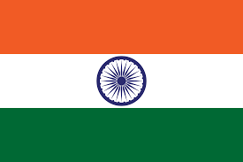
Notes:
We will especially be looking at the data of Australia, the reigning world champions who won their 6th title this year, and we will also be looking at data of the Indian cricket team who came to a close second this year, with 0 losses until the final.

Slide 5
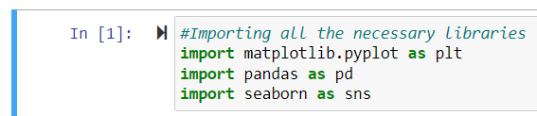
Importing

Slide 6
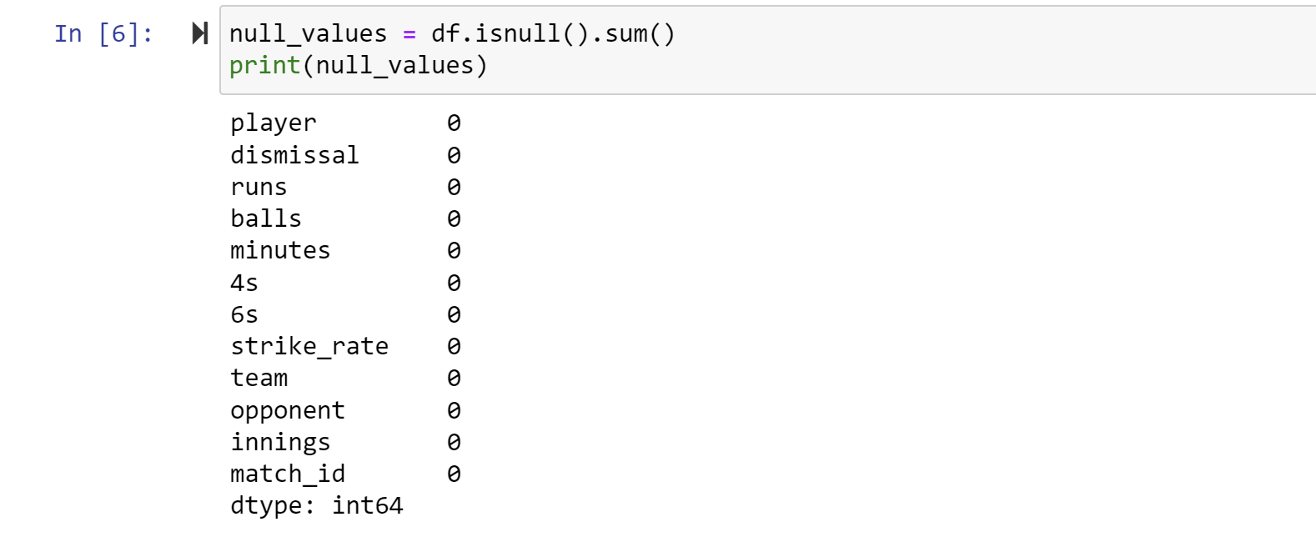
Checking for Null values

Slide 7

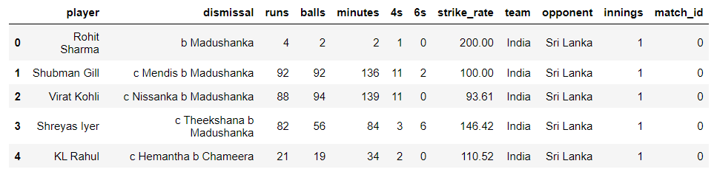
Reading the file

Slide 8
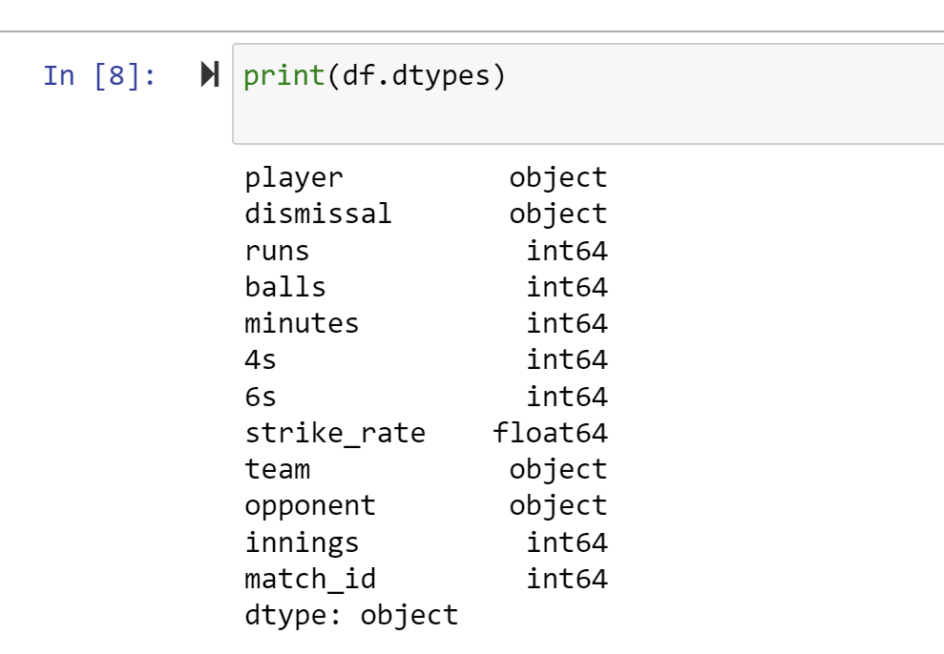
Checking Data Types

Slide 9
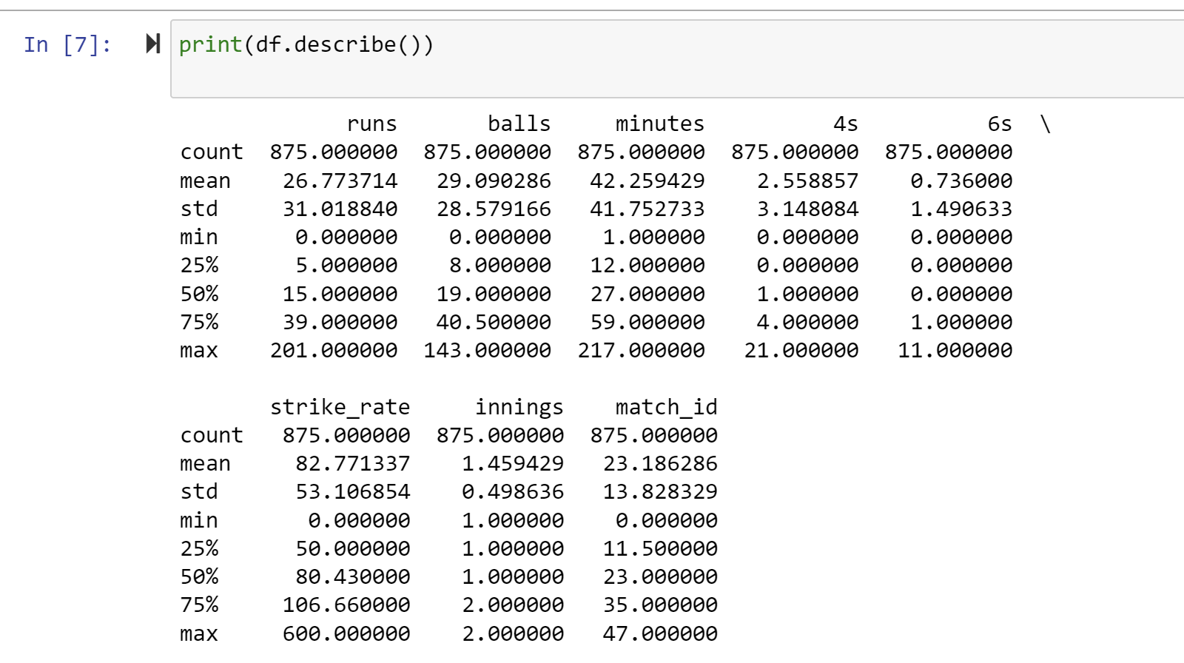
Describing the Dataset

Slide 10
The financial landscape of cricket teams can evolve due to changing market dynamics, team performance, and the overall popularity of the sport.

Slide 11
The budget for the world cup for the Indian cricket team this year was 84 crores inr or 10 million usd. This was a 40% increase from the previous budget set in 2019 and has contributed to the practice of the players which has significantly improved the run rates of india as we can see in the graph.

Slide 12
The strike rate is defined by the average number of runs scored by a batter in the course of 100 balls.
The strike rate of batters this year were lead by Glenn Maxwell with a 150 followed by Henrich Klassen and on the seventh position was Rohit Sharma with a stat of 125.94

Slide 13
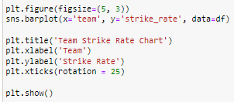
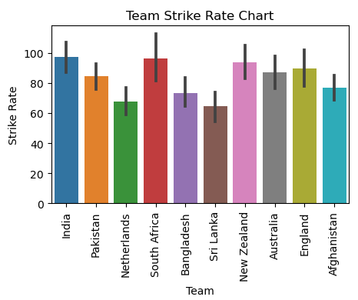

Slide 14
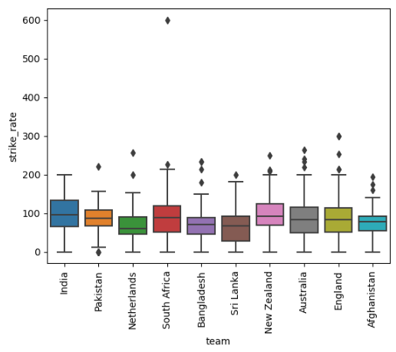

Slide 15
India's runs show a general increase in the first 80 minutes.
The exemplary performance shown by Shubhman Gill,
Suryakumar Yadav and many such players got India to score 140 runs in a staggering 60 minutes time period and at one point even managed to get us to 190 in 100 minutes.

Slide 16
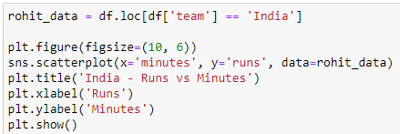
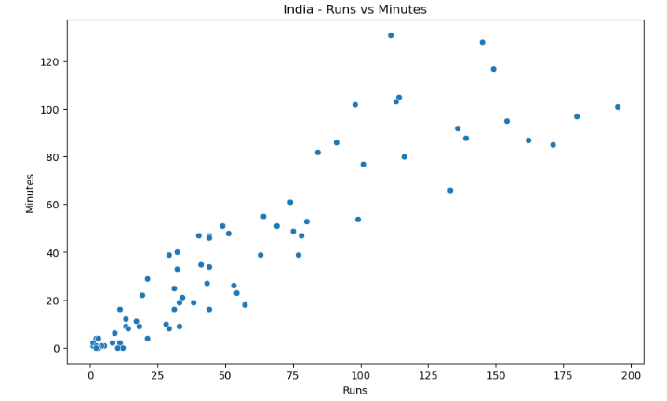

Slide 17
This colorful plot shows us runs scored by the teams participating in the men's world cup.
Australia gave an exemplary performance, one of the many factors contributing to this win other than the leadership and camaraderie were the rich cricket infrastructure and adaptability to the field and conditions of game.
The total runs scored by australia were under 3000 and india dominated as a powerhouse with the upper hand of over 3000 runs

Slide 18
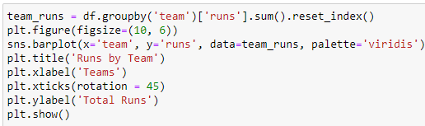
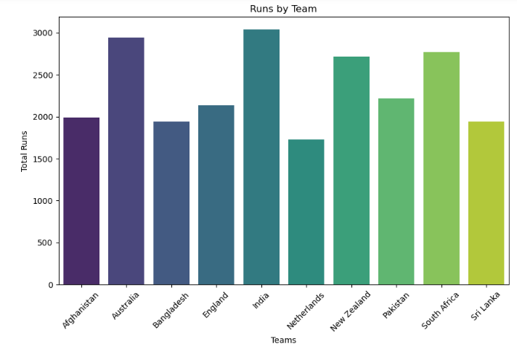

Slide 19
Rachin Ravindra - A rising kiwi star
Rachin Ravindra scored 578 runs in the ODI World Cup 2023 — a record for most runs by a batter playing his first World Cup. The feat helped him overtake the likes of legendary Sachin Tendulkar and the highly-rated Pakistani captain Babar Azam on the list. Rachin was also among the top run-scorers in the 2023 ODI World Cup and was named the player of the month by the ICC in October 2023.

Slide 20
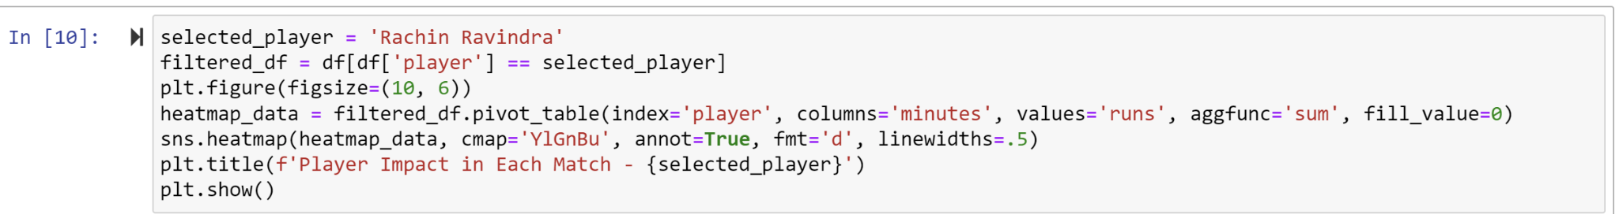
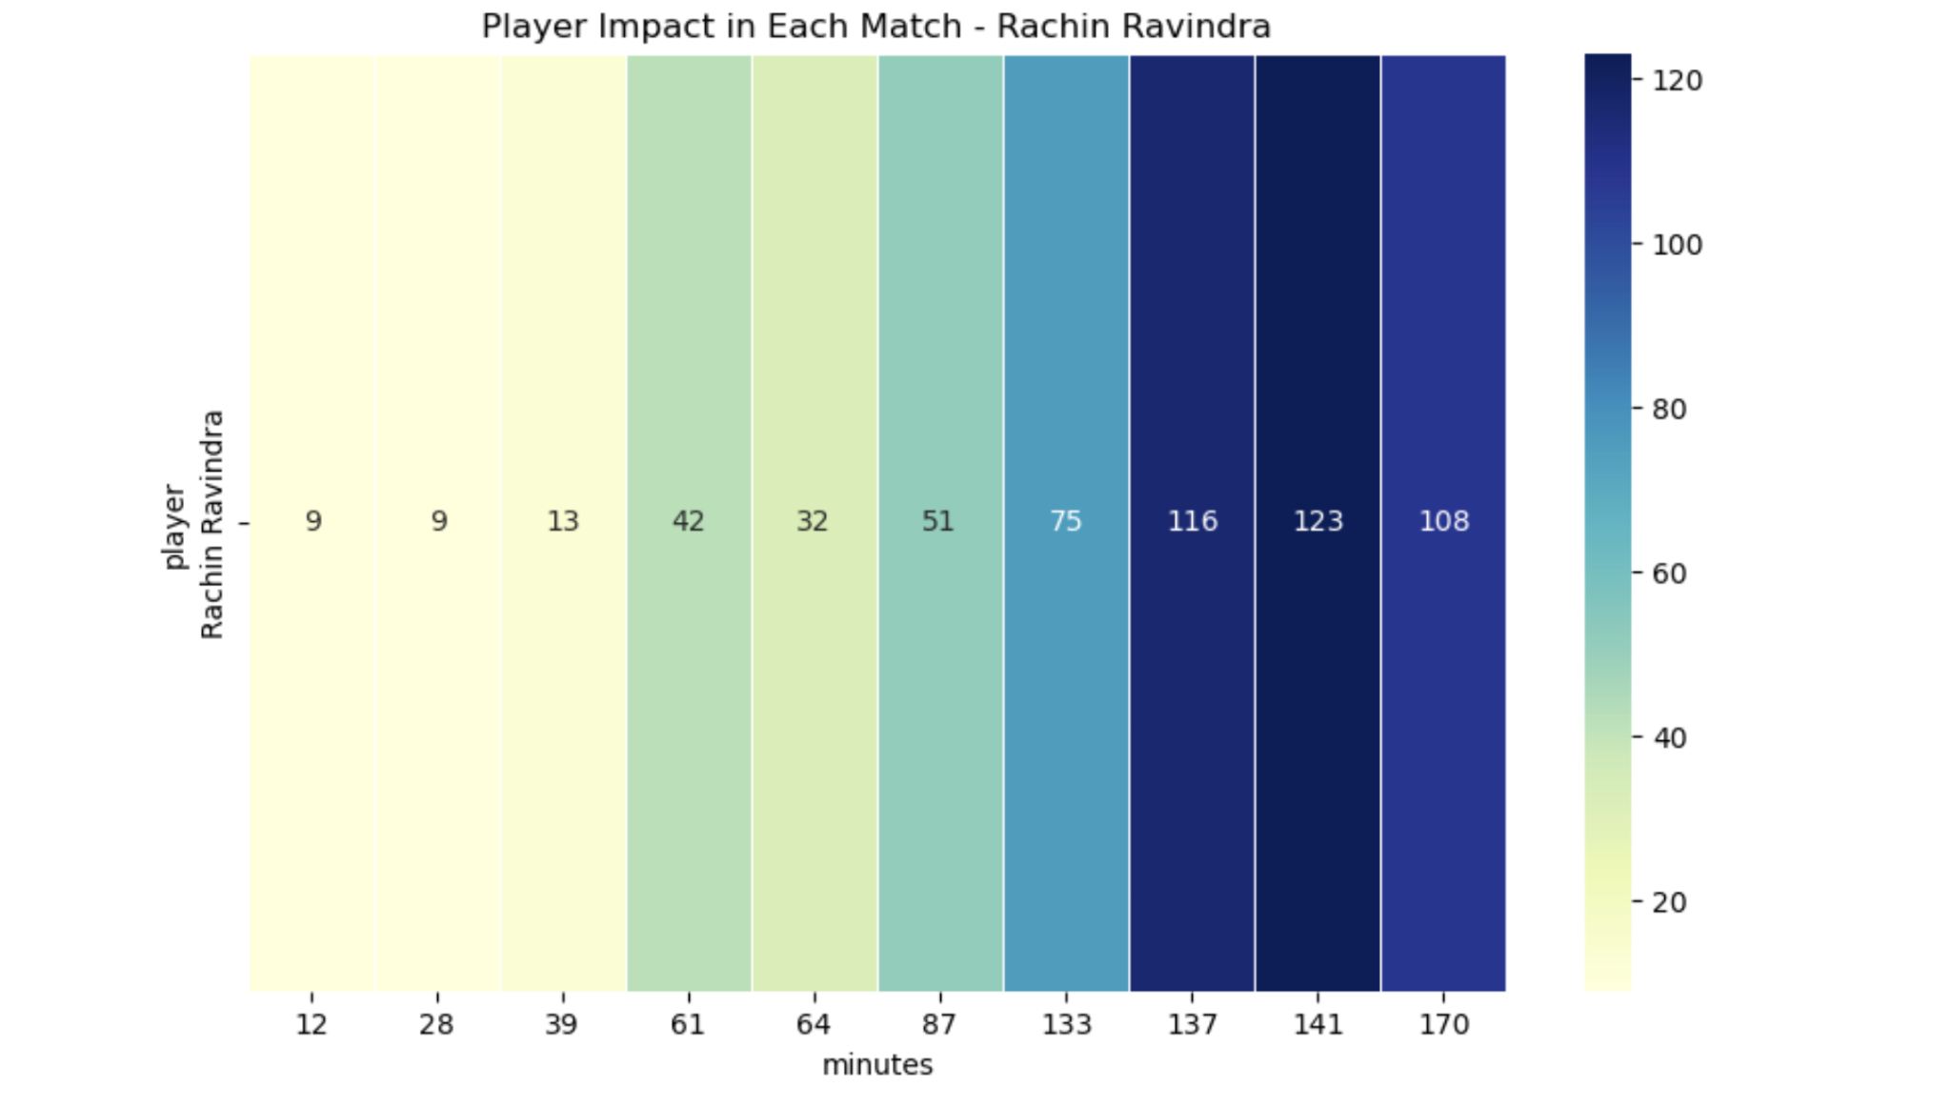

Slide 21
This graph highlights the number of boundaries (4s and 6s) scored by the two dominating teams, Australia and India. Australia has a slight dominance over India in the number of 6s scored.
This can be influenced by the pitch conditions during the game ,the batting style
of the teams and general game stratergy.
Notes:
Indian batsmen adopt a low stance and exhibit a driving tendency due to lower bounce on Indian pitches, while Australians stand more erect, favoring staying on top of the bounce and employing backfoot movement.
Indian footwork involves a small stride followed by a longer one, while Australians employ a back-and-across movement.

Slide 22
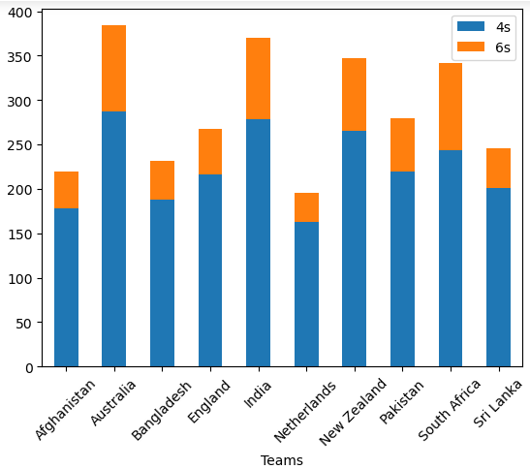

Slide 23
Travis Head was Australia's man for the big moments this year, piling up runs whenever he mattered the most.
He gave Team India and its fans sleepless nights with his performance in the ICC Cricket World Cup. He had an upward slope and is considered a steady player.
Virat did not have a consistent tournament, but he did have a increasing slope which can be seen in the graph. There are irregularities in between, especially compared to Travis Head.

Slide 24
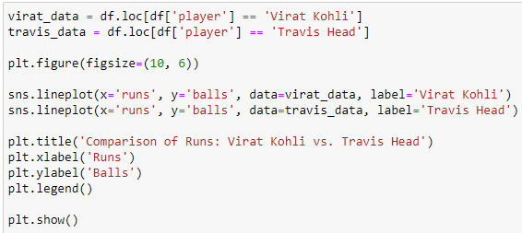
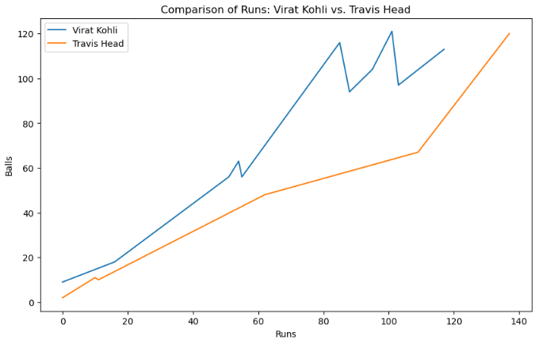

Slide 25
Virat Kohli’s performance in the ICC Cricket World Cup this year can be said to be one of the best in his entire career.
He either broke or has reached several cricket records.
711 runs in 9 innings, the highest ever in a single ODI World Cup, surpassing Sachin Tendulkar's 673 in 2003.
While his performance was phenomenal, scoring 54 runs, they were a leg short in the final against Australia and lost.

Slide 26
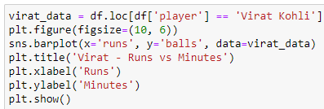
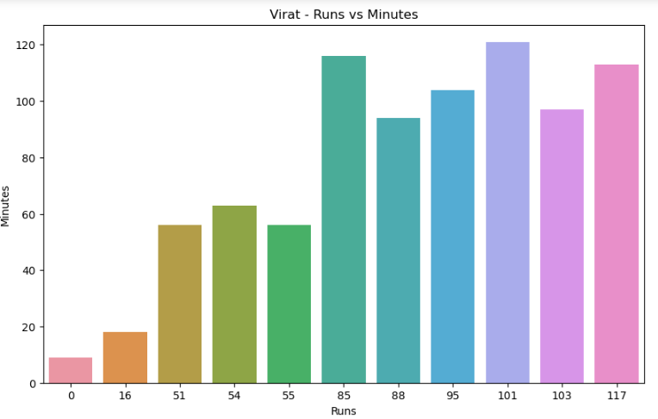
Notes:
711 runs in 9 innings, the highest ever in a single ODI World Cup, surpassing Sachin Tendulkar's 673 in 2003.
8 50+ scores, the most in a single edition, surpassing Tendulkar and Shakib Al Hasan's previous record of 7.
2 centuries, including a match-winning 117 in the crucial semi-final against New Zealand.
49th ODI century, equaling Sachin Tendulkar's record in the format.

Slide 27
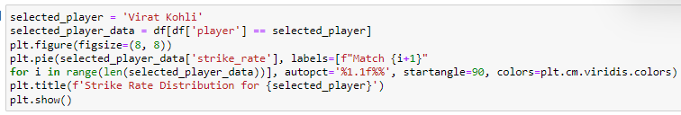
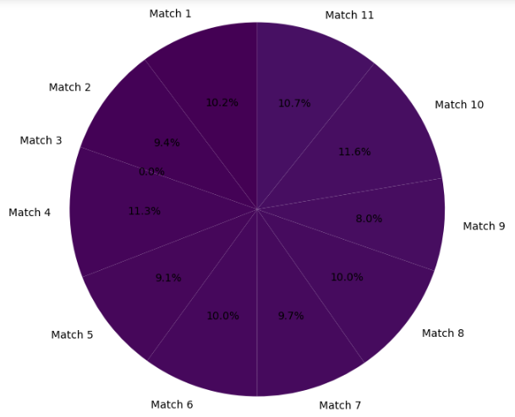
Notes:
This graph here shows the strike rate of virat in all of his matches.

Slide 28
THANKS

